Slide 1

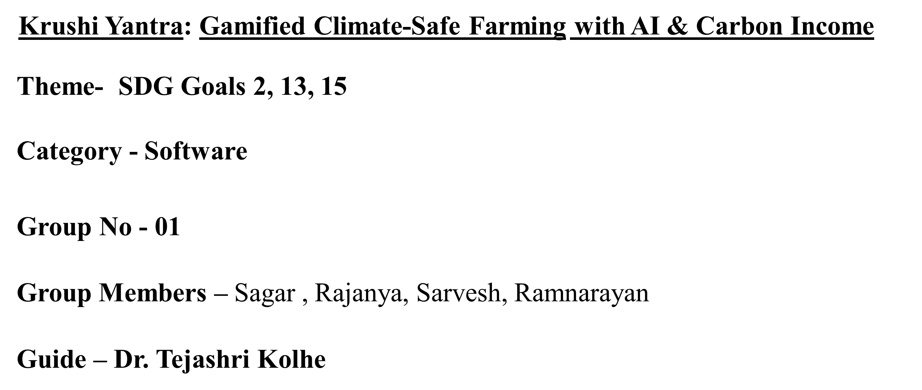

Slide 2
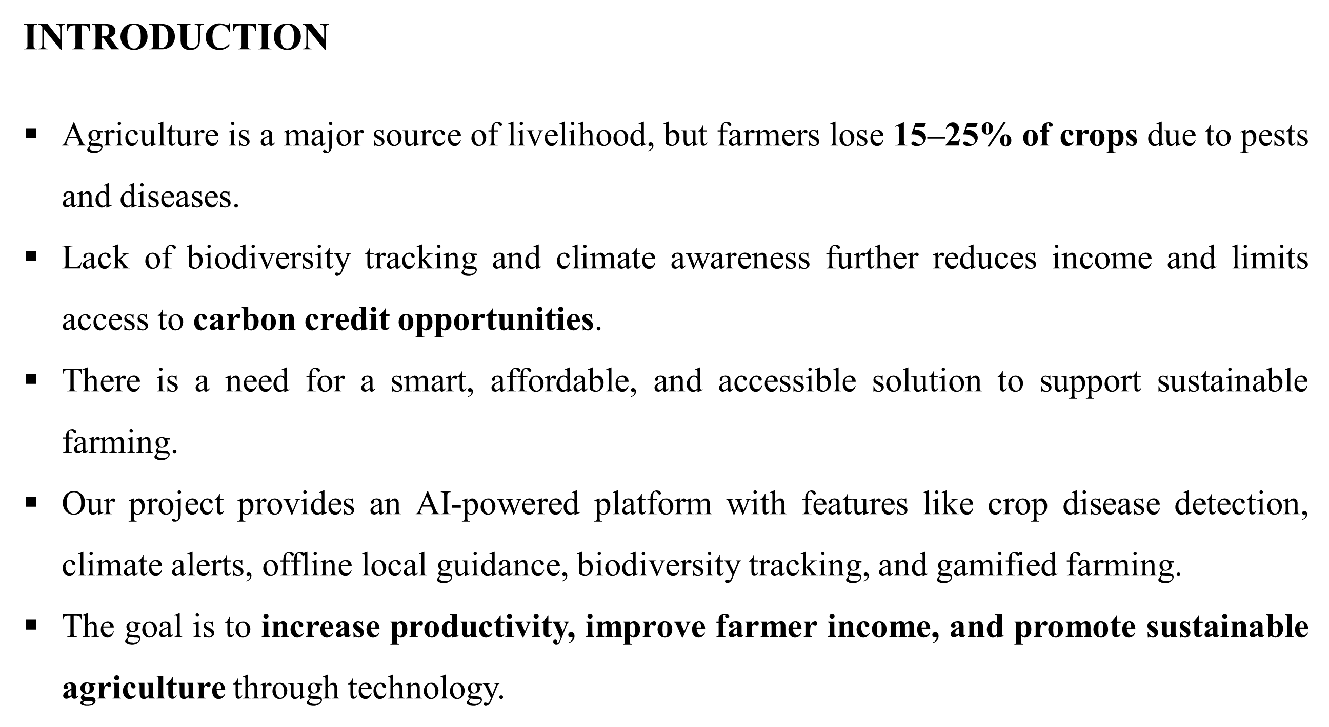

Slide 3
INTRODUCTION
Our project introduces a gamified farming platform inspired by the exploration excitement of Pokémon GO and the bite-sized learning approach of Duolingo.
It transforms agriculture into an interactive adventure where farmers earn rewards for monitoring crops, improving soil health, and tracking biodiversity.
By combining AI insights with engaging quests and challenges, the system encourages daily field activity and sustainable practices.
The goal is to make smart farming both educational and motivating while increasing productivity and environmental awareness.

Slide 4
Literature Survey
Author & Year (Citation) | Techniques / Method Used | Dataset Used | Key Results | Limitations
Mohanty et al., 2016 [1] | CNN for plant disease detection | PlantVillage Dataset | ~99% accuracy in controlled environment | Poor real-world adaptability
Sladojevic et al., 2016 [2] | Deep CNN classification | Self-collected leaf dataset | High classification accuracy | Limited dataset size & diversity
Ferentinos, 2018 [3] | Deep Learning (CNN models) | 87,000+ leaf images | 99.53% accuracy | Requires high computational resources
Too et al., 2019 [4] | Transfer Learning (ResNet, VGG) | PlantVillage | Improved prediction accuracy | Not optimized for low-end devices
Kamilaris & Prenafeta-Boldú, 2018 [5] | Review of DL in agriculture | Multiple datasets | DL improves yield & disease prediction | High dependency on large datasets

Slide 5
Author & Year (Citation) | Techniques / Method Used | Dataset Used | Key Results | Limitations
Zhang et al., 2019 [6] | IoT-based Smart Farming | Sensor-based real-time data | Improved field monitoring | High installation & maintenance cost
Khanna & Kaur, 2019 [7] | ML-based climate prediction | Weather datasets | Better climate risk forecasting | Limited integration with crop disease models
Liakos et al., 2018 [8] | ML algorithms (SVM, ANN, RF) | Agricultural sensor datasets | Random Forest performed best | Requires structured data input
Wolfert et al., 2017 [9] | Big Data analytics in agriculture | Agricultural Big Data | Increased farm productivity | Data privacy & integration issues
Carbonell et al., 2020 [10] | Carbon monitoring & sustainability models | Soil & biodiversity datasets | Promotes sustainable practices | Complex implementation & low farmer awareness

Slide 6
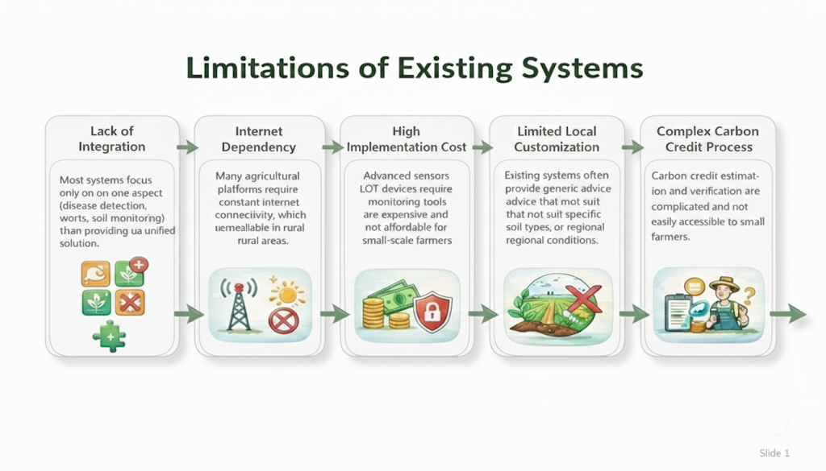
Limitations of existing systems

Slide 7
Problem Statement:
Farmers lose 15–25% of crops annually due to pests, diseases, and unpredictable climate conditions. Limited access to real-time alerts, expert guidance, and sustainable farming insights reduces productivity and income. Additionally, the lack of biodiversity tracking restricts opportunities for carbon credit benefits. There is a need for an integrated, AI-driven platform to provide smart, accessible, and sustainable farming solutions.

Slide 8
Proposed Solution:
Core Features
• Smart Farm & Carbon Credits Satellite mapping, auto carbon credits & AI crop suggestions
• AI Plant Disease Detection Camera-based detection with treatment & cost info
• ML Predictive Analytics Best crop, yield & ROI predictions using data
• Gamified Plant Explorer Fun plant discovery with points & learning
• 24/7 AI Farm Assistant Multilingual, personalized farming guidance

Slide 9
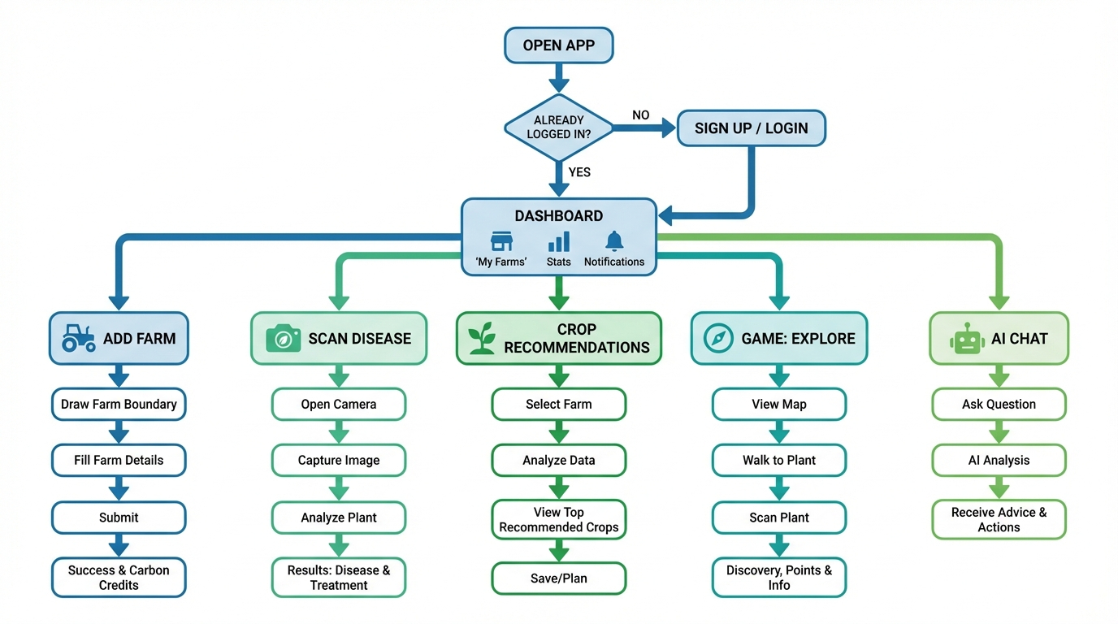
User Flow Diagram

Slide 10
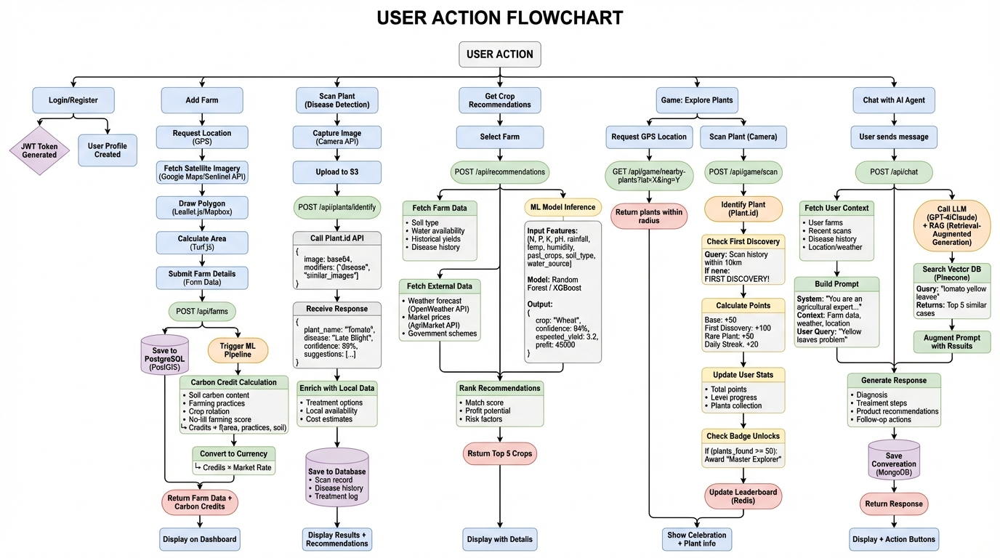
Experimental Setup

Slide 11
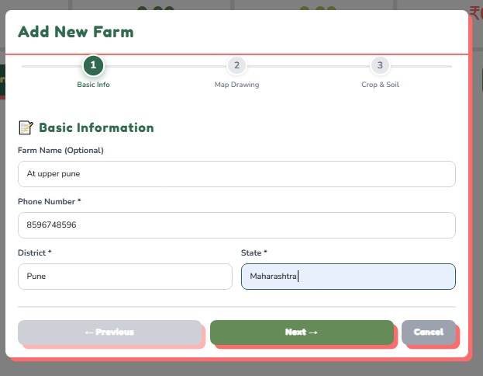
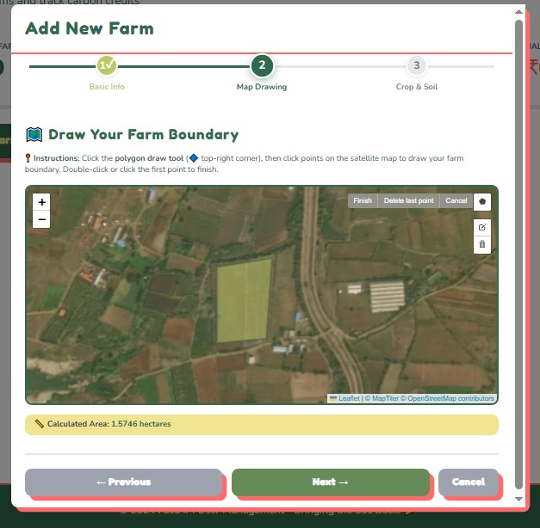
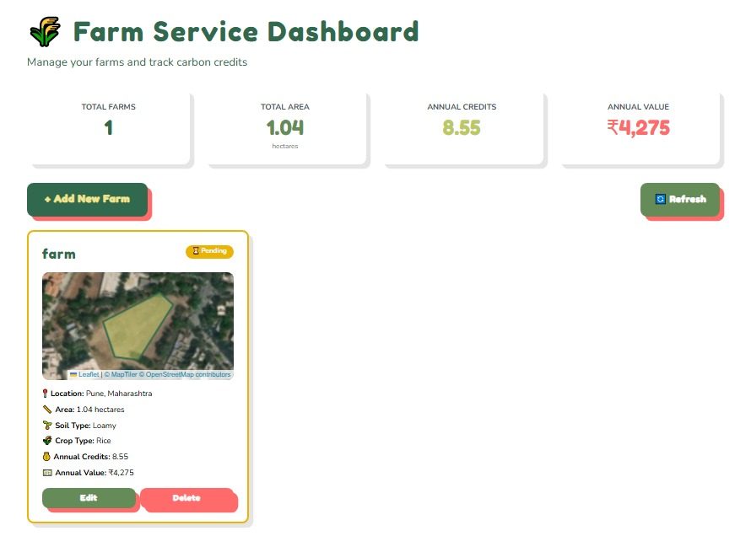
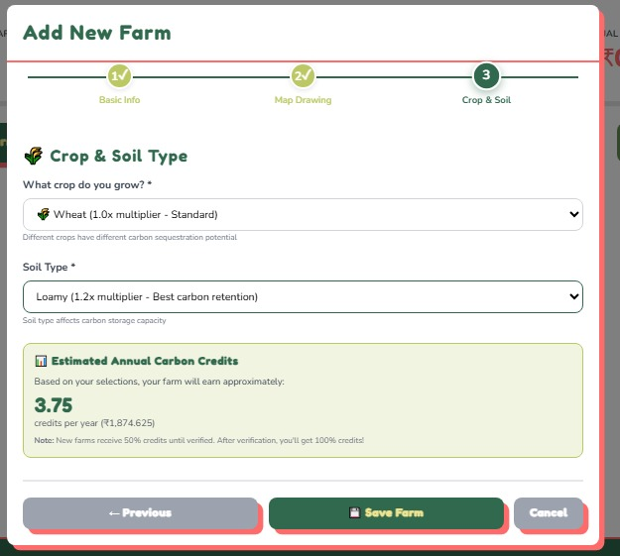
Implementation

Slide 12
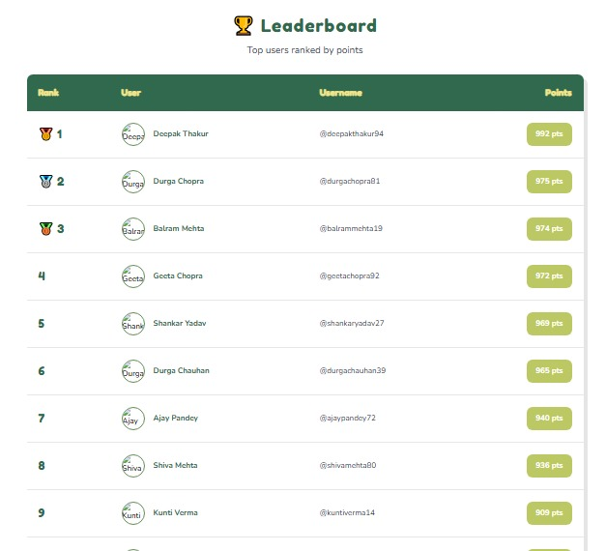

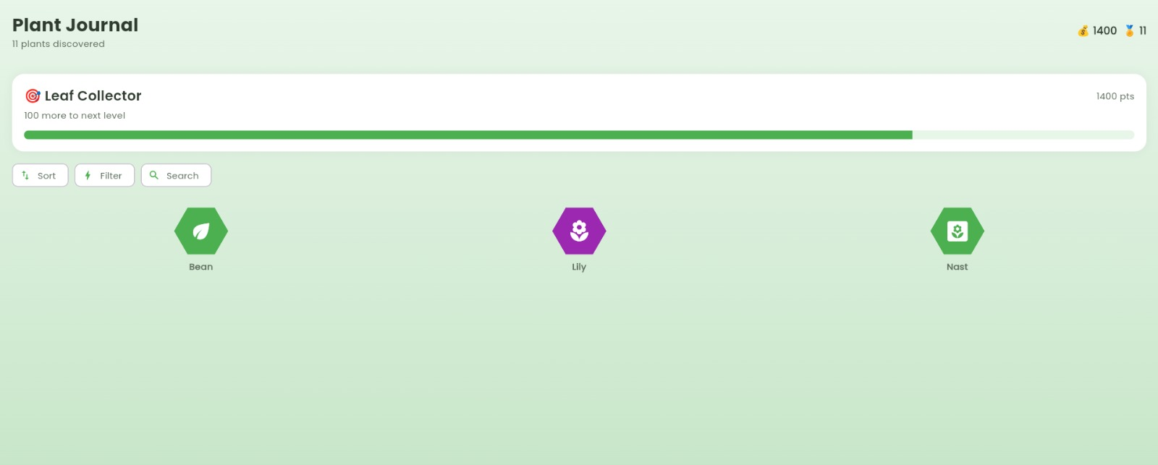

Slide 13
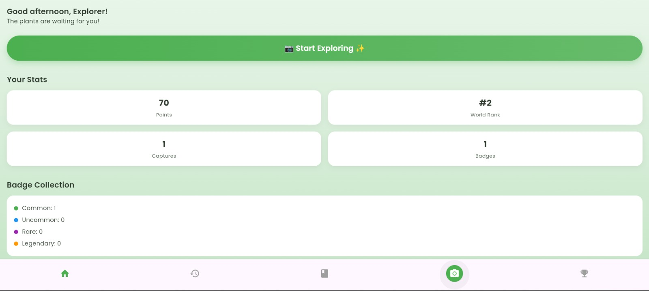
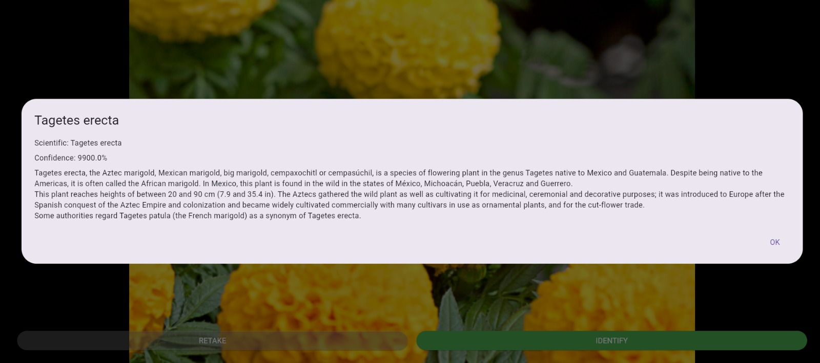


Slide 14
Results and Analysis
Improved Farming Decisions: Personalized crop suggestions based on farm history, soil, weather & market trends.
Reduced Crop Losses: Early plant disease detection helps prevent major yield damage and improves productivity.
Extra Farmer Income: Carbon credit calculation + ₹ conversion creates a new revenue stream for sustainable farming
.
Higher User Engagement: Gamified plant explorer increases daily app usage and learning interest.
Data-Driven Ecosystem: Continuous learning from user behavior builds smarter predictions and better recommendations over time.

Slide 15
Research and References
Plant disease detection using drones in precision agriculture – Chin et al. (Springer) A systematic review on the use of drones and machine learning for plant disease detection in precision agriculture. 🔗 https://link.springer.com/article/10.1007/s11119-023-10014-y
Smart Farming with IoT and Machine Learning for Crop Recommendation and Disease Detection Discusses IoT + ML for crop recommendation and disease prediction in smart agriculture. 🔗 https://www.ijraset.com/research-paper/smart-farming-with-iot-and-machine-learning-for-crop-recommendation-and-disease-detection
Predicting soil organic carbon with ensemble learning using satellite images – Mundada & Jain (Scientific Reports) Uses satellite data and ML for soil/carbon analysis, relevant to carbon credit estimation. 🔗 https://www.nature.com/articles/s41598-025-09804-3
AI based real time disease diagnosis in plants using deep learning (Scientific Reports) Real-time, automated CNN-based plant disease diagnosis relevant to your camera AI module
‹#›

